Slide 1
“Introduction to Salesforce”
Submitted : 2GI19IS016, 2GI19IS017
Under the guidance of
Internal guide: Prof. S K Madi
External guide: Apoorva and Sanjana, PwC.

Slide 2
Title :
“1. Add Reports and Dashboards to a Travel Approval
2. Communicate between Lightning Web Components-Explore different approaches to communicating between Lightning web components.”

Slide 3
PROBLEM STATEMENT 01 Add Reports and Dashboards to a Travel Approval- Use reports and dashboards to analyze your travel approvals any sample data for source to destination and the passenger details. OBJECTIVES Through this project we will learn to- Load Data Using the Data Import Wizard. Create a Travel Requests by Department Report. Create a Travel Requests by Month Report. Create a Travel Approvals Dashboard.

Slide 4
INTRODUCTION Salesforce is a cloud-based software company that provides its customers with a platform to develop their own applications without following the tough steps that they used to follow in the legacy system. The software or application once created can be uploaded onto the cloud allowing the end-users to view them. Salesforce is currently providing various software solutions and platforms for developers to create and distribute custom software/applications. Tech giants like Google, Twitter, Amazon, and Facebook are using Salesforce either in the form of SaaS or PaaS. How great would it be to get a report in your inbox every morning that shows the number of open travel requests waiting on your approval? Or access a report that provides all the key information of your travel approvals across your departments and their status? And see that information displayed as a graphical chart via a dashboard from your desktop or a mobile device? Good news because that is all possible.

Slide 5
ADVANTAGES It keeps your team on track. An in-depth sales report might not always be what your team needs to stay on pace to meet its goals. The top-level information that a Travel Approval dashboard presents can be enough to tell your salespeople what needs to get done now and what can wait, saving the time and effort of analyzing detailed reports. It streamlines your team’s work. Analyzing reports isn’t the only sales activity that takes time – so does generating those reports. With Travel dashboards, your team can rapidly determine which tasks should be done first without clicking through your dashboard to pull up reports. This function can save tremendous amounts of time. It results in stronger sales processes overall. Since Travel dashboards bring your sales team’s work into the present tense, they result in better overall sales performance. A current picture of your sales pipeline and your prospects’ progress along it is far more meaningful to your team than data from an old report, so Travel dashboards are especially powerful in guiding your sales team.

Slide 6
DISADVANTAGES The integration part is time consuming. There can be some restrictions on the embedding of the dashboards. Users/business teams should have Salesforce Developer accounts and authorize appropriate permissions to set up and work with Travel Analytics Dashboard.

Slide 7
SUMMARY Through this project we learned to – Embed a dashboard in a Lightning Experience home page. Embed a dashboard in a Lightning Experience account page. Use a filter to show only data that’s relevant for a particular record.

Slide 8
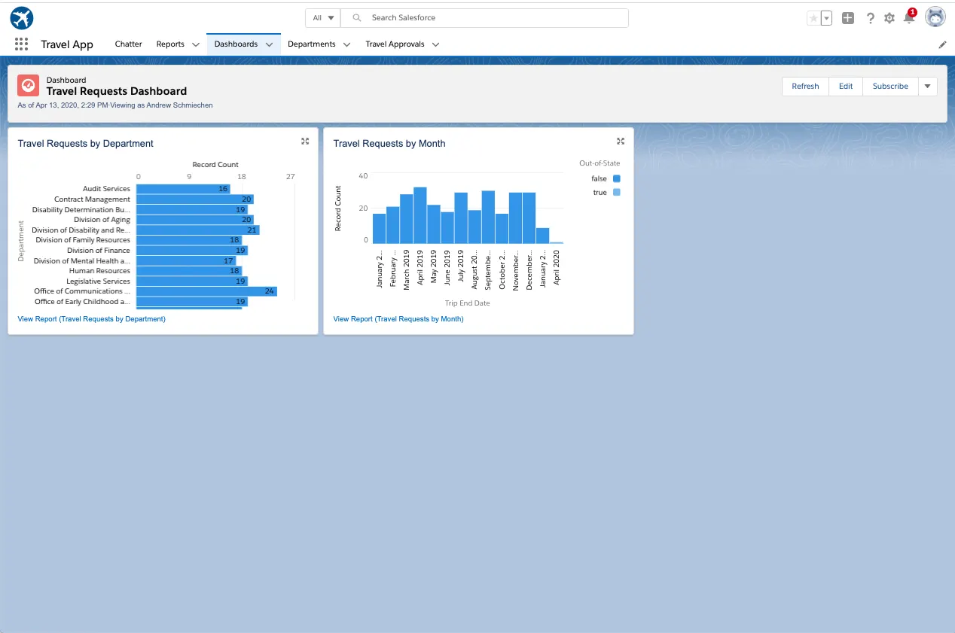
RESULTS:

Slide 9
PROBLEM STATEMENT 02 Communicate between Lightning Web Components-Explore different approaches to communicating between Lightning web components. OBJECTIVES Through this project we will learn to- Communicate from Child to Parent. Communicate from Parent to Child. Communicate Between Unrelated Components.

Slide 10
INTRODUCTION Salesforce is a cloud-based software company that provides its customers with a platform to develop their own applications without following the tough steps that they used to follow in the legacy system. The software or application once created can be uploaded onto the cloud allowing the end-users to view them. Salesforce is currently providing various software solutions and platforms for developers to create and distribute custom software/applications. Tech giants like Google, Twitter, Amazon, and Facebook are using Salesforce either in the form of SaaS or PaaS. When multiple Lightning web components compose an app, we often want those components to share information. How we communicate from one component to another depends on whether and how the components are related. A component inside another component creates a parent-child relationship. How a parent communicates with a child is different from how a child communicates with its parent. And those are both different from how unrelated components (components in separate DOM subtrees) communicate with one another.

Slide 11
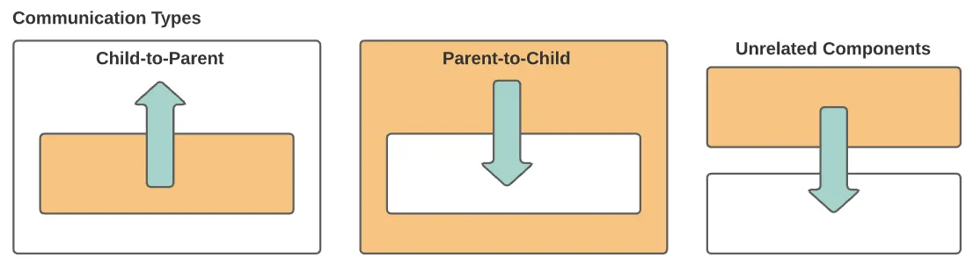
DESIGN –SCHEMA DIAGRAM/USE CASE/ER DIAGRAMS

Slide 12
ADVANTAGES Tracks internal requests for headcount as they move through the approval process Analyzes candidate demographics to identify new-hire recruiting patterns Monitors the number of applicants for each open position and the status of each of those applicants This application will remove the manual creating multiple sheets which will consume lot of time and hard work and also automate the recruitment process and make it easy and simple. Admin can access the list of candidate and also can select the candidates who fulfill the requirement of the organization. This application will help us to keep the details of the candidates in each step of selection process, the list of candidate who got selected in each step of recruitment process.

Slide 13
DISADVANTAGES The recruitment application project has certain limitations such as- In this application the list of selected students in each round of interviews is still done manually HR selects the list and creates the emails manually. Another limitation is that there must be an active and stable internet connection and a browser application for the users to make use of this application.

Slide 14
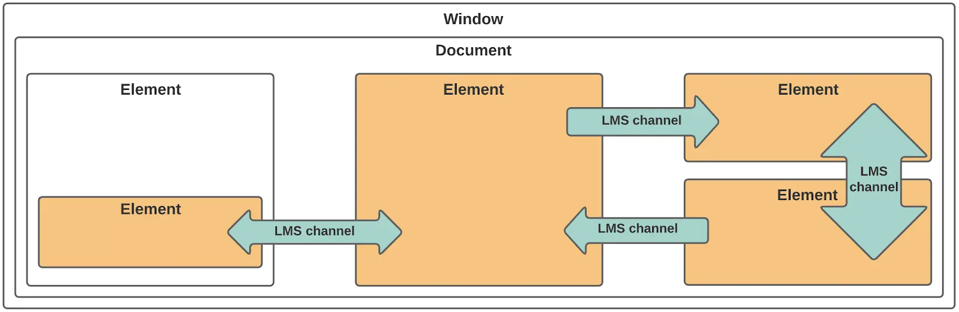
RESULTS :

Slide 15
SUMMARY Through this project we learned to – We have tackled both child-to-parent and parent-to-child communication between Lightning web components. In the next step, you use the Lightning message service to communicate between components that don’t have a parent-child relationship.

Slide 16
Thank you!

